Slide 1



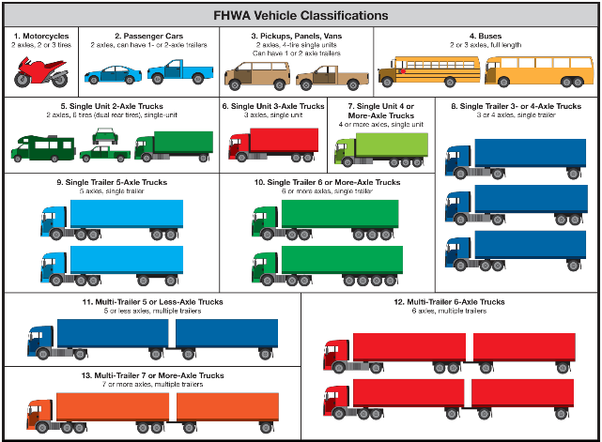

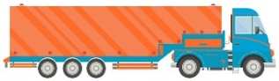

Speaking the Same Language: Cross-walking Truck Classification Systems for Efficient Freight Modeling
GVWR
8.5-10k lbs.
Kaveh Shabani
Fatemeh Ranaiefar
Long-haul

Slide 2
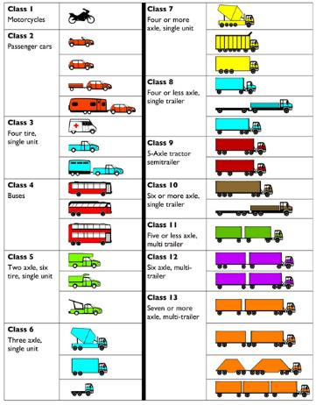
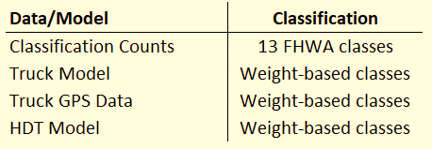
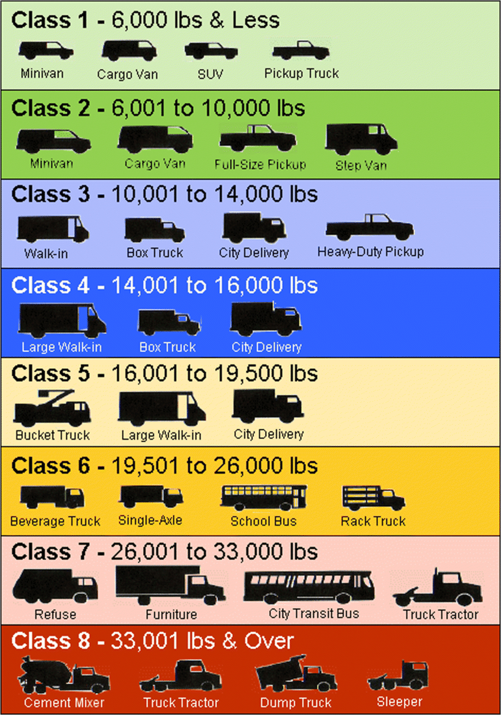
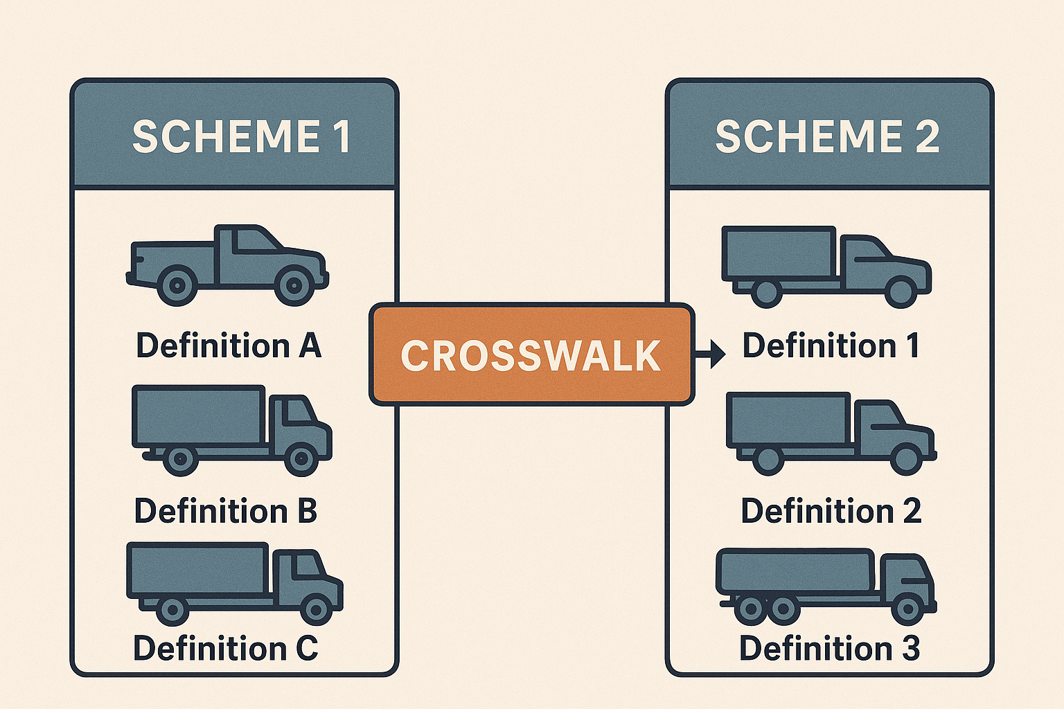

Background
Various vehicle classifications
axle-based
weight-based
Various classes based on GVWR
Crosswalks needed!

Slide 3

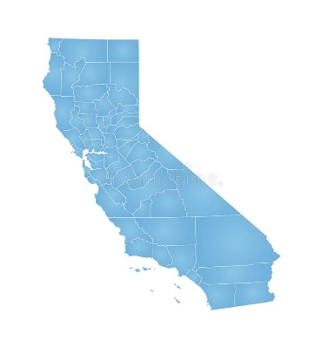
Data Sources
National VIUS (Vehicle Inventory and Use Survey), 2002 (and 2021)
National survey of truck drivers
Surveyed about 100k (150k in 2021) truck drivers
Currently used in freight models for payloads and percent empties
All truck weights (no empty weights in 2021 data)
Activity type in 2021 data (some commercial activity vs. personal use only)
~ 57% of data records: “some or all commercial activity” (~17% of total vehicles)
~ 14% of data records: “vehicle not in use” or “not reported” (~8% of total vehicles)
Less detail on number of axles in 2021 data
National FHWA Study, 2021
Uses vehicle registration data from 2019
More details on FHWA Classes 3 and 5
Sample Size: 1.3 M (U.S.), expanded: 175 M (class 2 and above)
California VIUS, 2017
Only trucks serving California
Truck weights > 10k lbs.
More than 50% of surveyed trucks > 33k lbs.
Sample size: 14.7k (CA), expanded: 759k (CA)

Slide 4
FHWA-13 Class Compositions (2002 National VIUS)

Slide 5
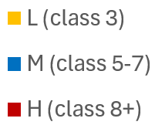
SCAG HDT Truck Classes (National VIUS vs. California VIUS)
Vehicles with different weight characteristics can have similar number of axles. For example, this can be seen when larger pickups pull utility trailers. (The FHWA would still classify it as a Class 3 vehicle.)

Slide 6
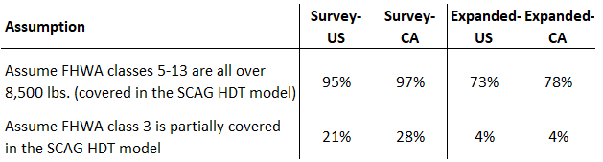
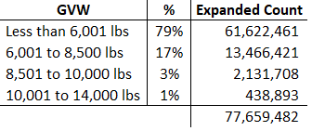
Approach for FHWA Class 3 (2 axle-4 tire)
National VIUS (2002) - CA
*FHWA study (2020)
Uses vehicle registration data from 2019 for all U.S.
Four private vehicle registration data sets acquired by the FHWA
Uses a methodology to assign FHWA-13 vehicle classification to observations in the mixed-duty and heavy-duty vehicles data
Distinguishes between two-axle, four-tire and two-axle, six-tire vehicles (i.e., FHWA-13 class 3 and 5)
The approach uses proxy variables such as GVWR, Fuel Type, Number of Cylinders, Engine Displacement, etc.
Sample size: 1.3 million, expanded: 175 million (class 3 and above)
Details of data expansion not disclosed!
Move some of class 5 to LHDT in a later update!
Expanded National VIUS (2002) – FHWA Class 3 trucks (only commercial vehicles)
Estimated All Commercial Vehicles in FHWA Class 3
Estimated Commercial Vehicles in FHWA Class 3
With 8.5-14k lbs. GVW
All Class 3 trucks in National VIUS = 78,065,379
FHWA Study (2019 private registration Data for all vehicles in the U.S.)
Notes:
*linking FHWA and NHTSA Vehicle's Type , Cambridge Systematics for FHWA – the report is under review by FHWA

Slide 7
Crosswalk for SCAG
FHWA 13-class to SCAG truck class Conversion (updated)
FHWA/SCAG | LH | MH | HH
3 | 82% | 18% | 0%
5 | 35% | 64% | 1%
6 | 5% | 25% | 70%
7 | 5% | 5% | 90%
8 | 25% | 5% | 65%
9 | 0% | 3% | 97%
10 | 0% | 3% | 97%
11 | 0% | 5% | 95%
12 | 0% | 0% | 100%
13 | 0% | 0% | 100%
~80% of FHWA Class 3 are commercial vehicles
~3% of FHWA Class 3 are included in the HDT model
~2.6% to LH, 0.4% to MH
The composition of trucks vary spatially and temporally. So, a fixed mapping factor is needed but not adequate.
Trip rates, Trip distribution, Mode cost, Port trips, Intermodal trips, TOD factors, Trip assignment, Model validation

Slide 8
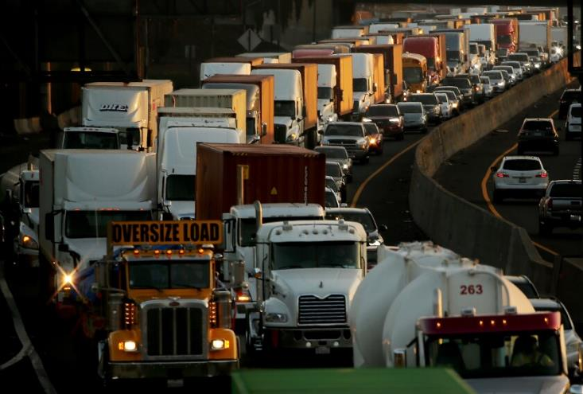
Contact
Kaveh Shabani
kshabani@camsys.com
C: 971-344-4323

Slide 9

Appendix

Slide 10
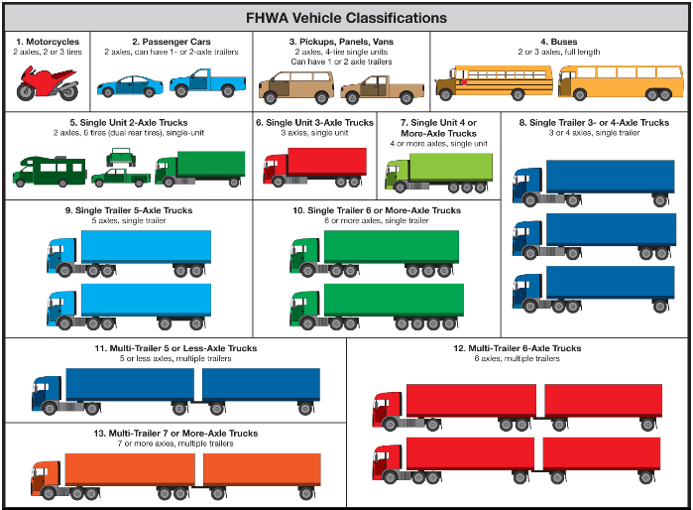
FHWA Truck Classification

Slide 11
FHWA Truck Classification

Slide 12
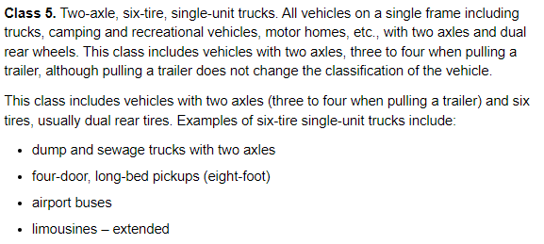
FHWA Class 5
Source: txdot.gov

